Slide 1
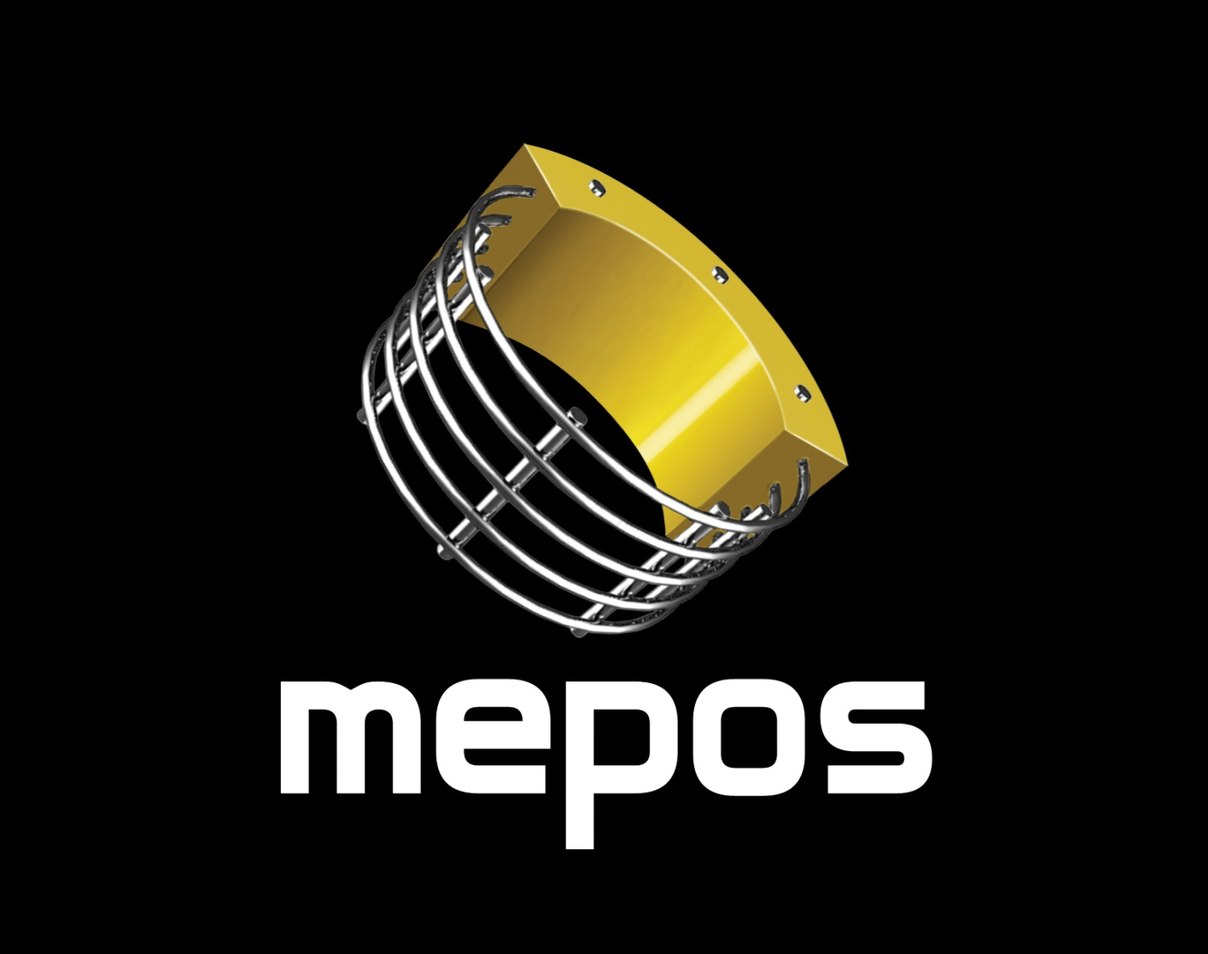

Slide 2
About Us
Company established in 1990
Technology developed for uranium heap leaching on depths up to 800 meters
Production facility is located in Yekaterinburg, Russia
Patented technology of continuous production line
Russian and international quality certificates API Spec. Q1; ISO/TS 29001; ISO 9001:2000
Our clients are the biggest Russian companies Gazprom, Lukoil, TNK-BP
More than 2000 kilometers of pipeline laid

Slide 3
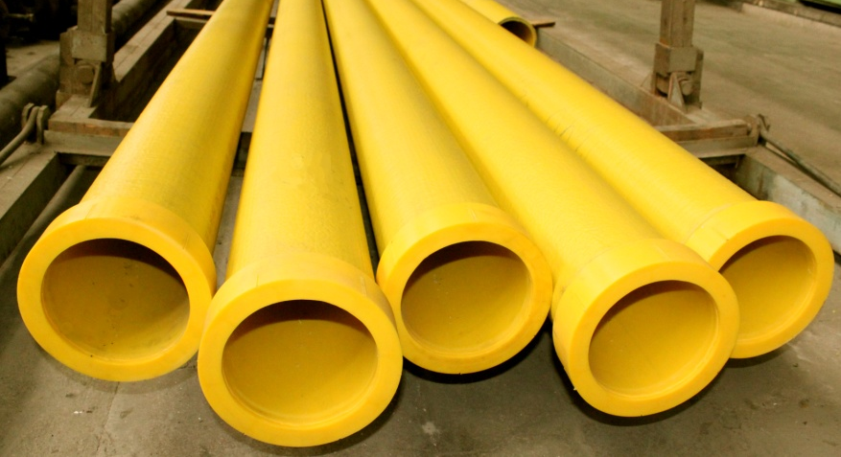
Products
MPP is a polymeric pipe reinforced by a rigid metal carcass made of steel wire There can be several different variations of polymers used. These can be polyethylene, polypropylene etc. Such a variability provides the final product with different individual characteristics
A rigidity of a steel carcass plus chemical resistance and specific qualities of the polymer used provide our final product with unique multifunctionality.
Industries of use:
Oil and gas transportation
Hydrometallurgy
Mineral fertilizers production
Water transportation
Artesian boring

Slide 4
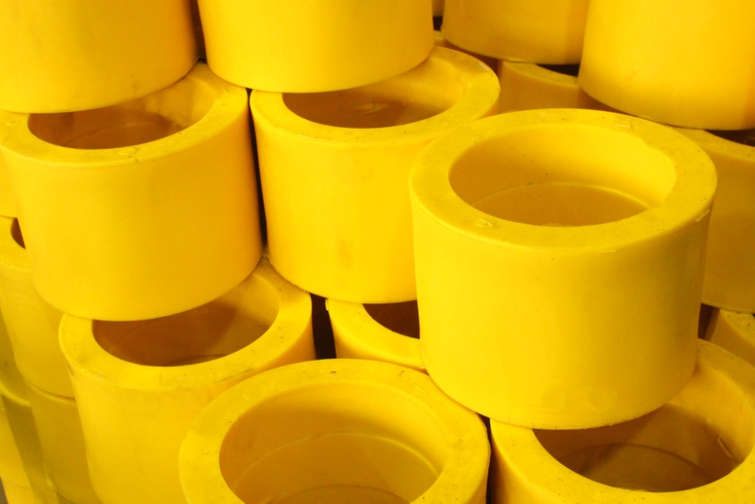
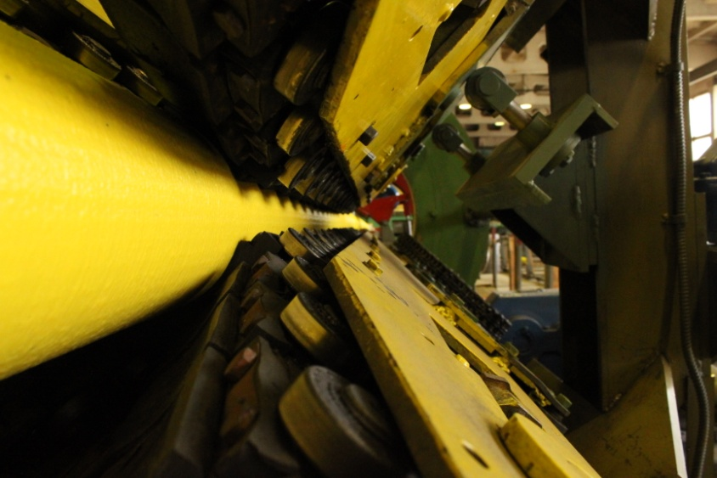
Technology
We have built a unique single production line with only one extruder, working automatically
One of the stages of the production process is double-sided cooling system which allows us to escape the appearance of rough crystallized structures at macromolecular level
We use calibration by the inner diameter of a pipe. This process makes pipes inner surface as glib as mirror

Slide 5
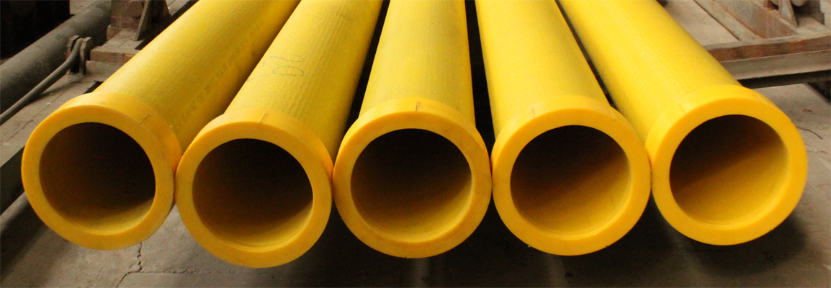
Products
MPP
Pipe bends
Т-like fittings
All types of pipe joints

Slide 6
Products
Pipes specifications
 | Dimensions, mm |  |  |  | Specifications
 | Outer diameter | Wall thickness | Wire diameter | Weight, kg | Draft-end load, кNт, not less than | Hermeticity under the constant pressure during 1 hour, Mpa, not less than | Ultimate stress Mpa, not less than
MPP 95 | 95 | 11,0 | 3,0 | 6,51 | 6,0 (60) | 10,0 (105) | 19,0 (190)
MPP 115 | 115 | 11,5 | 3,0 | 8,51 | 7,2 (72) | 9,0 (90) | 15,0 (150)
MPP 140 | 140 | 12,0 | 3,0 | 10,22 | 9,0 (90) | 7,5 (75) | 13,0 (130)
MPP 160 | 160 | 12,0 | 3,0 | 12,37 | 11,0 (110) | 6,0 (60) | 11,5 (115)
MPP 200 | 200 | 12,5 | 3,0 | 15,35 | 14,0 (140) | 5,4 (54) | 9,0 (90)
MPP 225 | 225 | 12,5 | 3,0 | 17,58 | 16,0 (160) | 4,8 (48) | 8,0 (80)

Slide 7
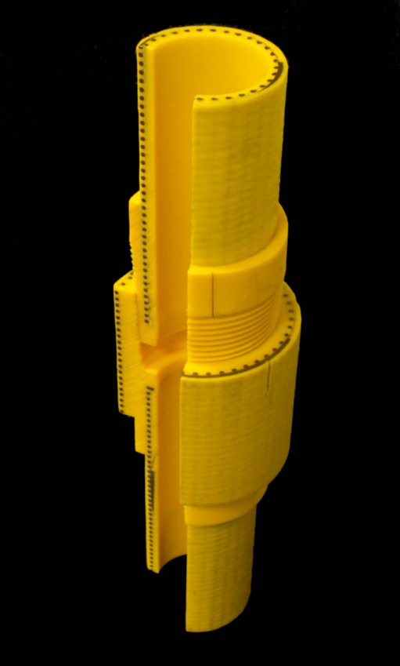
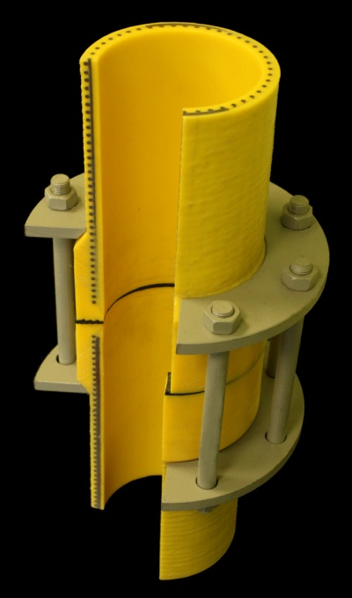
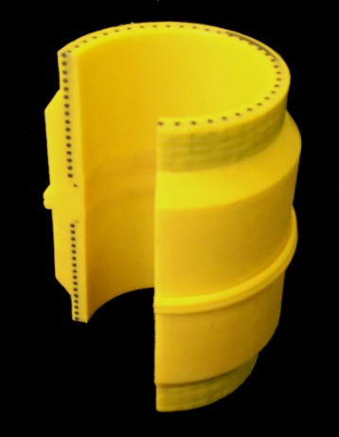
Products
Joint types
Welded joint
Flange joint
Screw joint

Slide 8
Product Advantages
The rigidity of our pipes is comparable to the rigidity of steel pipes but MPP’s are more resistant to aggressive matter
Thermic stretching coefficient is equal to that of a steel pipe
The MPP’s longevity exceeds all analogues’ operating life
MPP’s don’t require cathodic protection
MPP’s don’t require anticorrosive protection
MPP’s are three times lighter than steel pipes which allows to avoid the use of special equipment during the pipe laying
Compared to regular polymeric pipes MPP’s allow to raise working pressure by more than four times which makes possible the use of 2-3 times smaller pipe diameter
MPP’s abrasive resistance coefficient is four times higher than that of the steel pipes

Slide 9
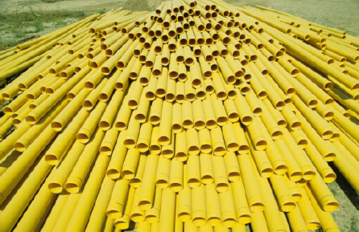
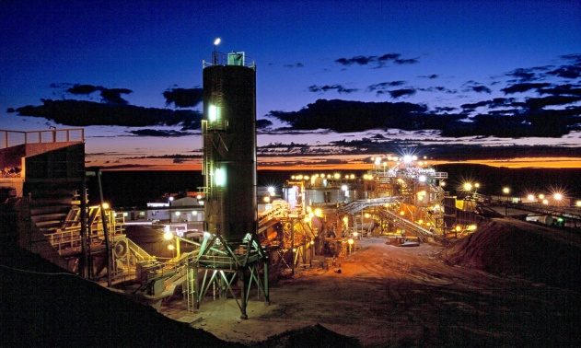
Application Areas
Oil extraction and oil and gas transportation. Gas circuits with working pressures up to 90 atm (depending on the diameter)
Acids, alkalies and salts transportation
Underground and heap leaching of nonferrous and rare earth metals
Mining sector – when transporting aggressive pulp (ore mixed with water)

Slide 10
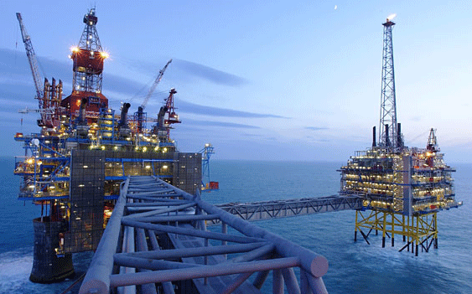
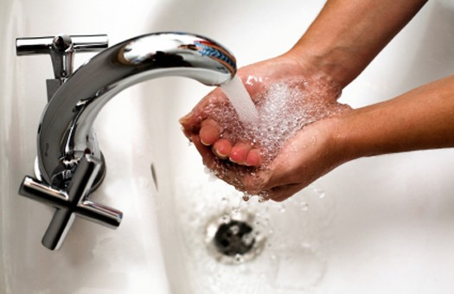
Application Areas
Pipelines for water transportation, heating supply, drainage and other spheres of municipal services
Artesian boring (as casing pipes)
Transportation of salt water, seashore infrastructure, undersea pipelines, seashore reinforcement, ports and docks construction, bearing constructionsl

Slide 11
Economic Efficiency

Slide 12
Abrasive resistance
Abrasive resistance by Darmstadt method

Slide 13
Reduction Coefficient

Slide 14
Ecological advantages
MPP’s production’s ecological impact is not higher than that of regular polymeric pipes production.
Polymeric pipes are more durable than metal pipes.
Mass production of MPP will decrease the metal pipes production which will consequently lower its’ negative ecological impact.
Resistance to corrosion of MPP decreases significantly the risk of oil and aggressive fluids outflows.

Slide 15
Thank you for your attention

